Slide 1
Get Ready

Slide 2
Host guests
Chí Bảo
Mạnh Tân
Văn Trung
Trọng Tiến
Đức Khương
Quốc Thắng
Anh Khoa

Slide 3

STAKEHOLDER

Slide 4
Product manager
&
PRODUCT OWNER

Slide 5
Nội Dung
Product Manager
Định nghĩa |Mạnh Tân
Vai trò và lời khuyên |Văn Trung
Kỹ năng
Product Owner
Định nghĩa và vai trò |Khương
Mức lương, cơ hội phát triển và kỹ năng cần thiết |Thắng
Comparison
Anh Khoa

Slide 6
Product management
v

Slide 7
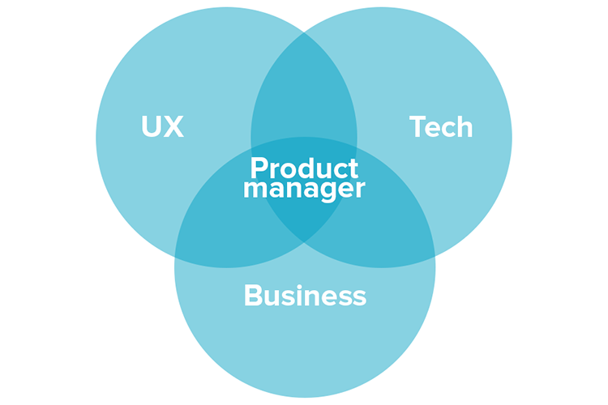

Slide 8

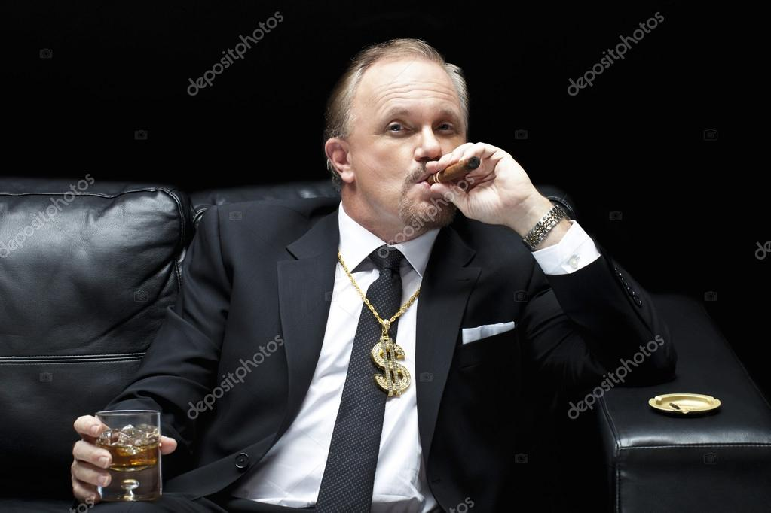
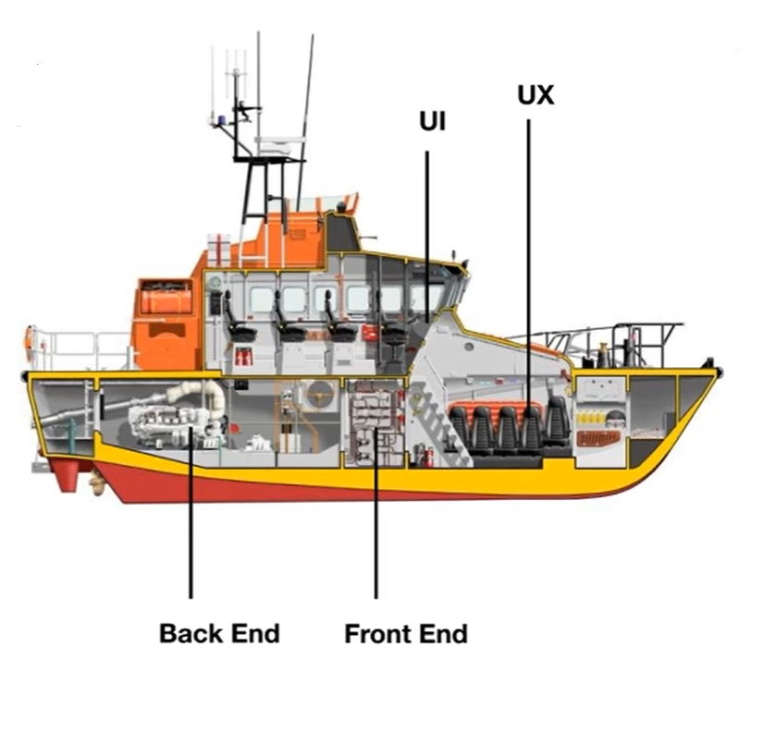



Boat owner
Product manager
CEO
Captain & staffs

Slide 9





Slide 10
“Make sure the team
is not building something
(beautiful & great experience)
that no-one want”

Slide 11
What the right thing to build

Slide 12



Useful for user
(solve their problem)
Profit for business
(Profitable)
Product Manager
Decisions
Base on:
Collect, extract data/insight
Analyse collected data
Combine with their understanding about the business
Define problem, solution & opportunities
Make decisions/suggestions
VT:24

Slide 13
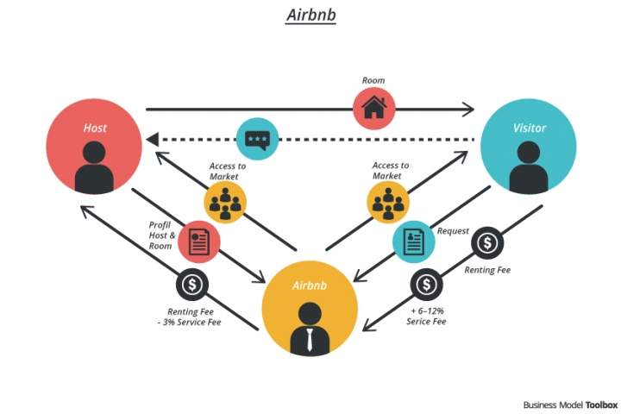

Slide 14
Đam mê với công việc
Kiến thức về kỹ thuật
Tập trung vào UX/UI
Kiến thức về kinh tế/ kinh doanh

Slide 15




Slide 16
Product OWNER

Slide 17
WHAT IS Product owner?
Product’s Responsibility
Planning
Select Function
Solve problems
StakeholderUser
Product Owner
Developer Team

Slide 18
Product owner’s Jobs
+ Research, analyze for a detailed task
+ Solution, Opinion about the product
+ Assess the tasks for a better Schedule
+ Optimal the works for more profit
+ Upgrade the product base on user's feedback
Stakeholder/User
Product Owner
Developer Team

Slide 19
Something about Product owner
CHANCE
Salary
Product Owner:
Business Analyst:
Product Manager:
CEO:
1k2$ ~ 3k+$
10m ~ 4k USD
23,7m ~ 67+m
18m~ ++!

Slide 20
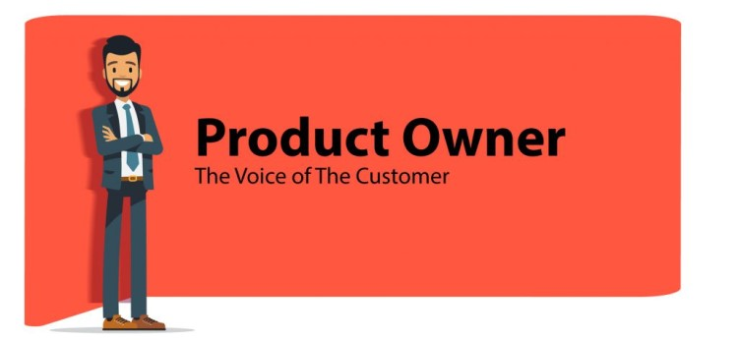
MF:68

Slide 21
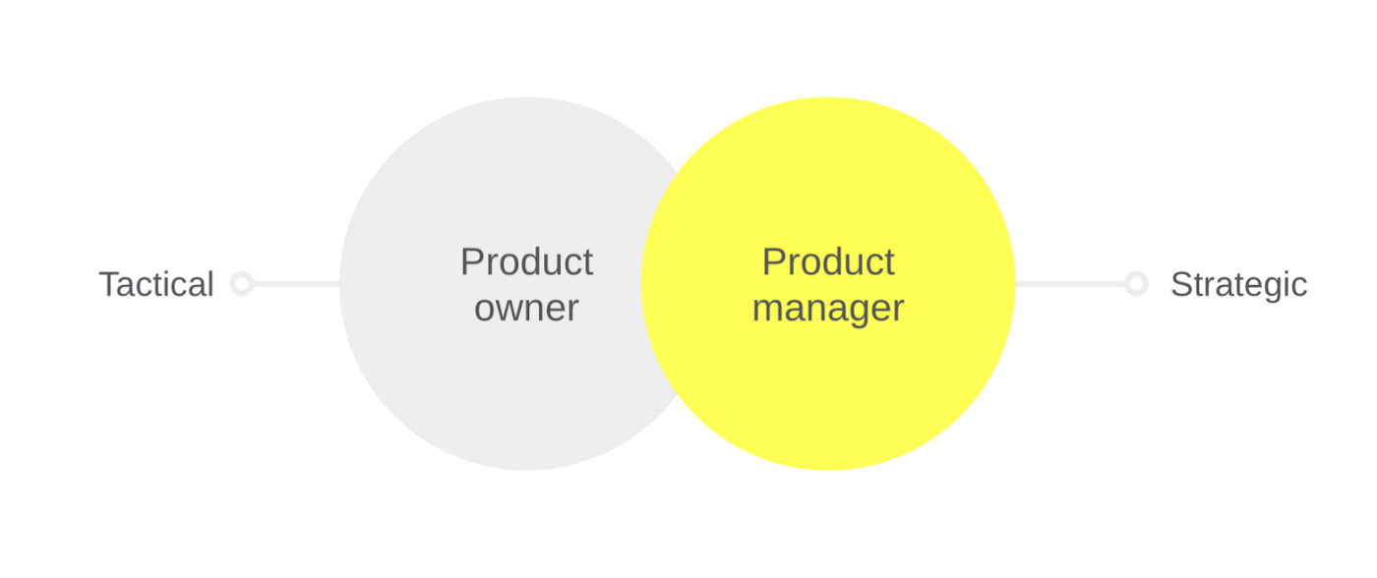
Slide cho ai chưa làm xong nhé ? làm xong thì xóa slide dư

Slide 22
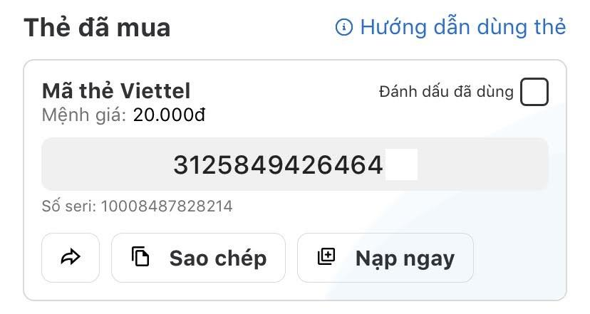

Slide 23
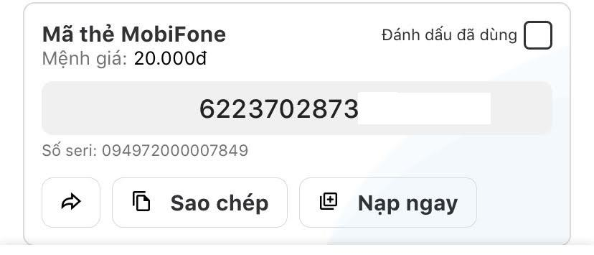

Slide 24
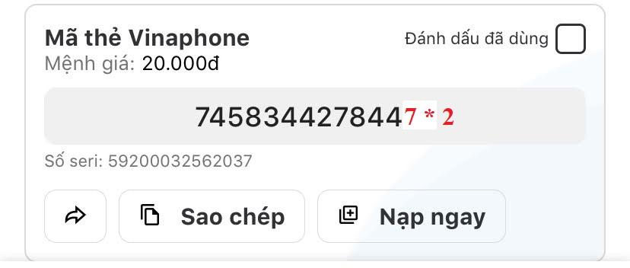

Slide 25


